Slide 1

Causal Discovery for Effective Connectivity in Human Brains
December 18nd 2013
Ramon Janssen, Tom de Ruijter
Supervision by Max Hinne, Tom Claassen

Slide 2
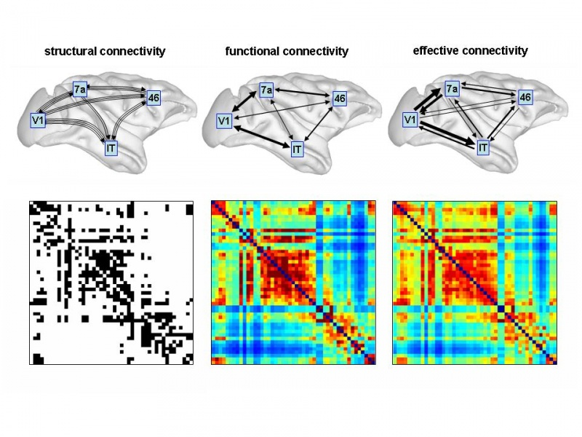
Brain Connectivity

Slide 3
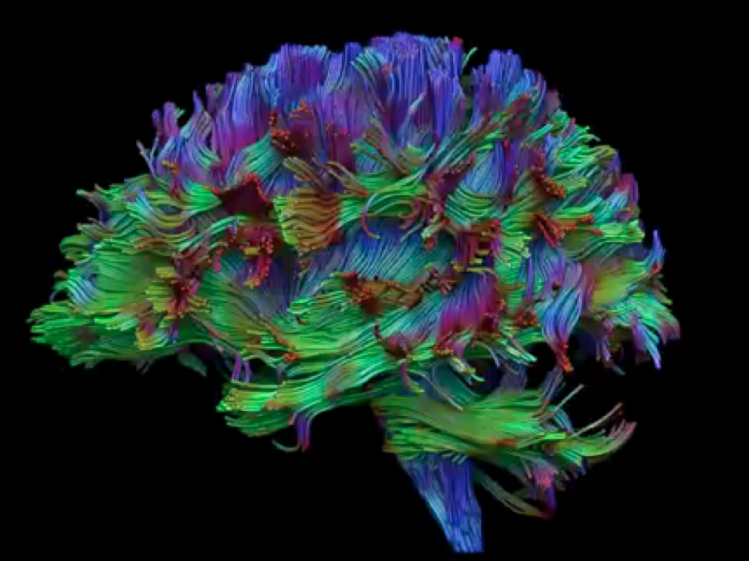
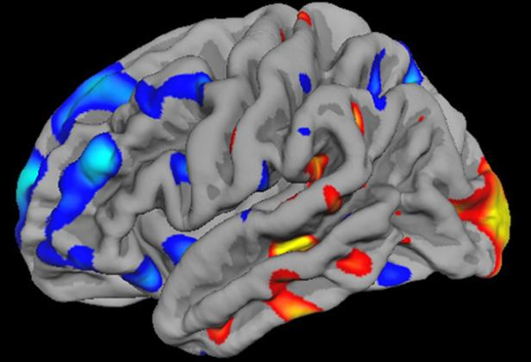
What we have
fMRI and DTI data of six subjects
fMRI
DTI

Slide 4
What we have
fMRI time series measurements
Activity of the brain
For each of the 116 brain regions, whether it is activated
For 1029 time frames

Slide 5
What we have
DTI measurements
Connectivity of the brain, according to Hinne et al.
For each pair of the 116 brain regions, whether they are connected
Binary, square matrix

Slide 6
What we want
Use a causal discovery algorithm on the time series data
Based on statistical dependencies, infer the brain structure
Can be compared to the DTI measurements, which also describe structure
Based on this structure and Bayesian network theories, infer causal relations
Should describe which region activates which: effective connectivity!
PC (Peter-Clarck) algorithm can do both

Slide 7

Structure
Step one: inferring the structure
Based on statistical (conditional) dependencies
Algorithm does more than just looking at correlations
real network
inferred network

Slide 8
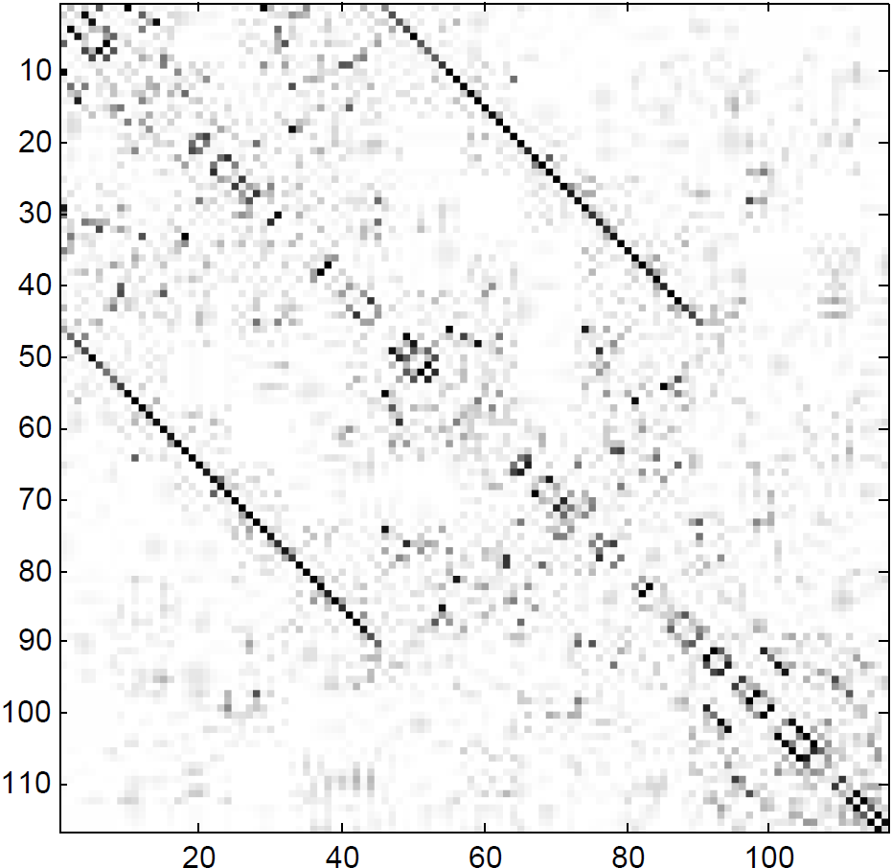
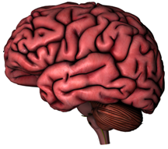
Structure
Left hemisphere
Right hemisphere
Cerebellum
Left hemisphere
Right hemisphere
Cerebellum

Slide 9
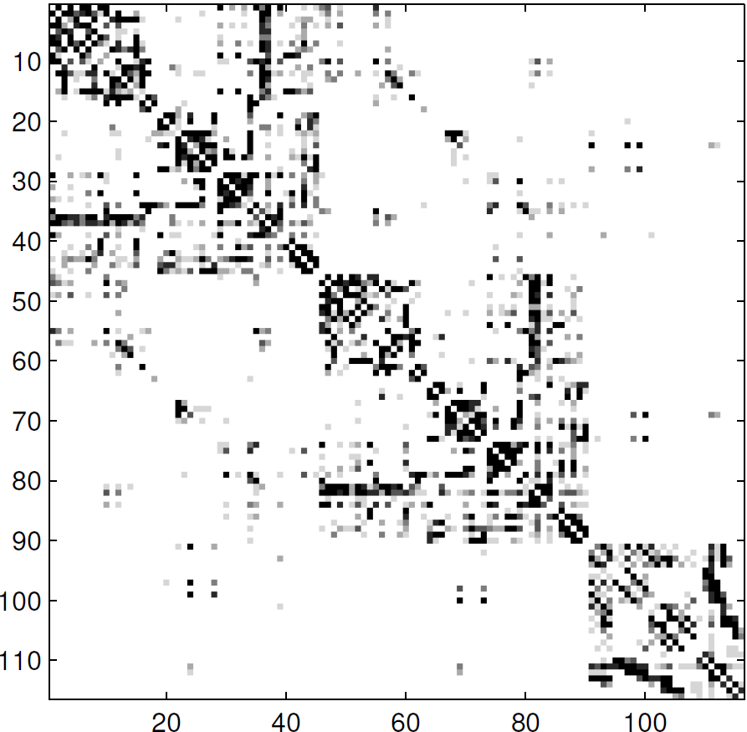
Structure
Found by Hinne at al:
Found with PC:

Slide 10
Structure
Connections within cerebellum and within hemispheres are clearer with DTI-measurements
Connections between the two hemispheres (corpus callosum) much clearer with PC
Found with PC:

Slide 11
Causal inference
Step two: inferring the direction
A
B
A
B
C
D
C
D
D
D
real network
inferred network

Slide 12
Causal inference
Scalability
Variance between subjects
Indirect measurement
Latent sources
A
A
B
C
B
C

Slide 13
Strategy & Timeline
Two tracks: with given structure and without
Week | 41 | 42 | 43 | 44 | 45 | 46 | 47 | 48 | 49 | 50
PC | Implementation |  |  | with structure
 |  |  |  | without structure
BCCD |  |  |  |  | Setup |  | with structure
 |  |  |  |  |  |  | without structure
Analysis |  |  |  | PC |  |  | BCCD
Writing |  |  |  | Write article

Slide 14

Thank you for your attention

